Slide 1
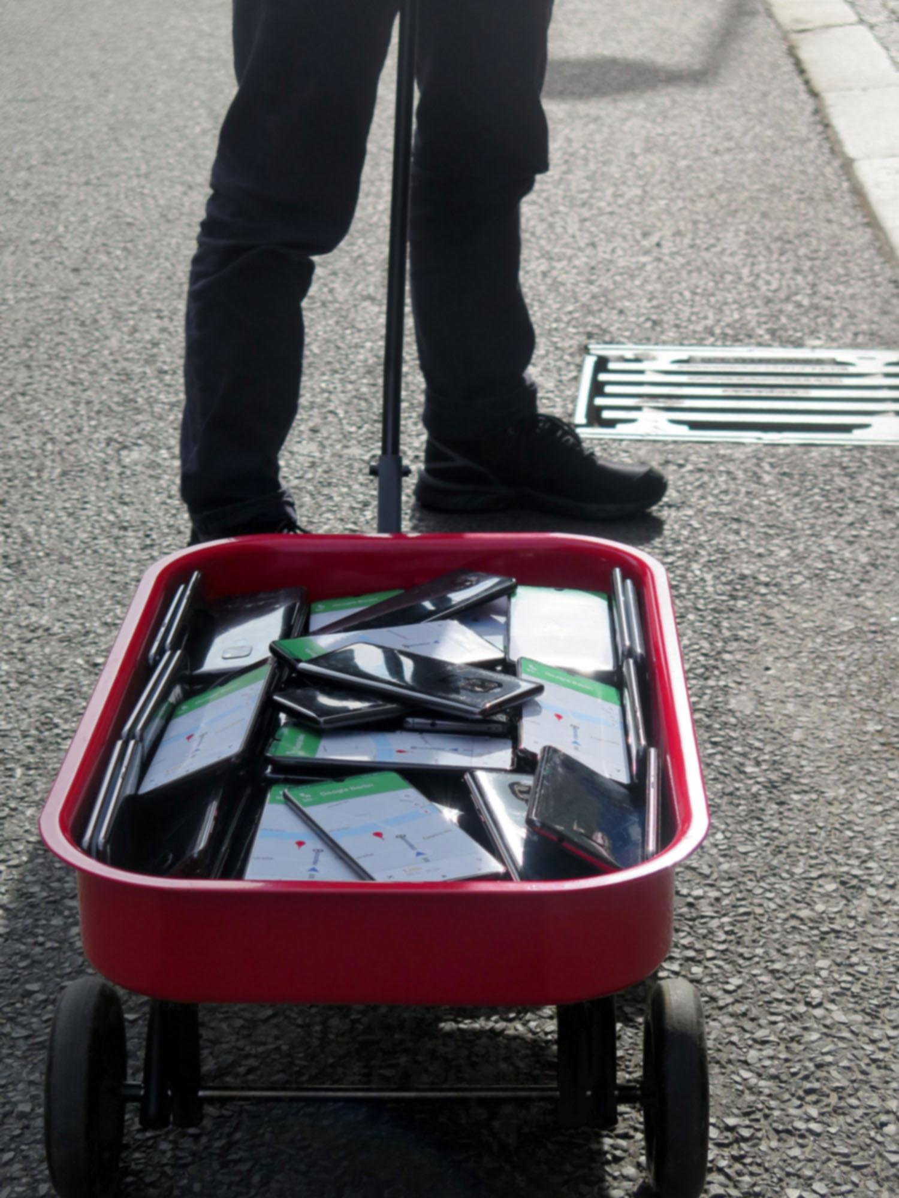
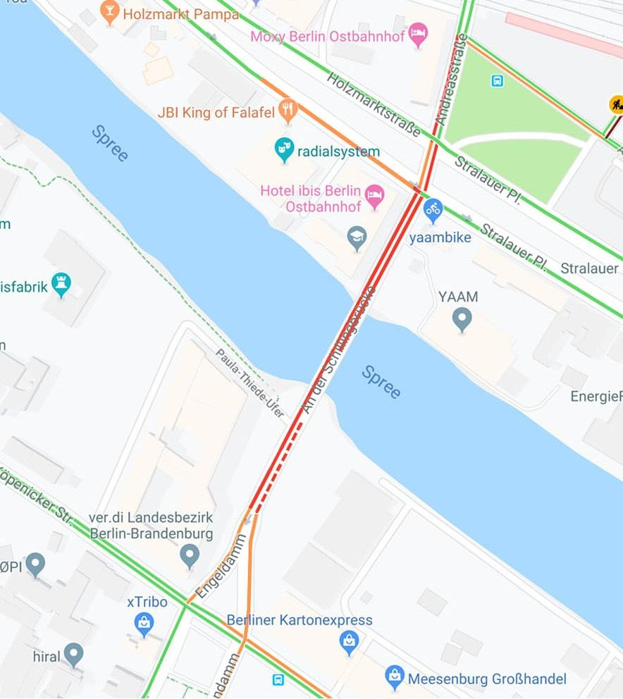
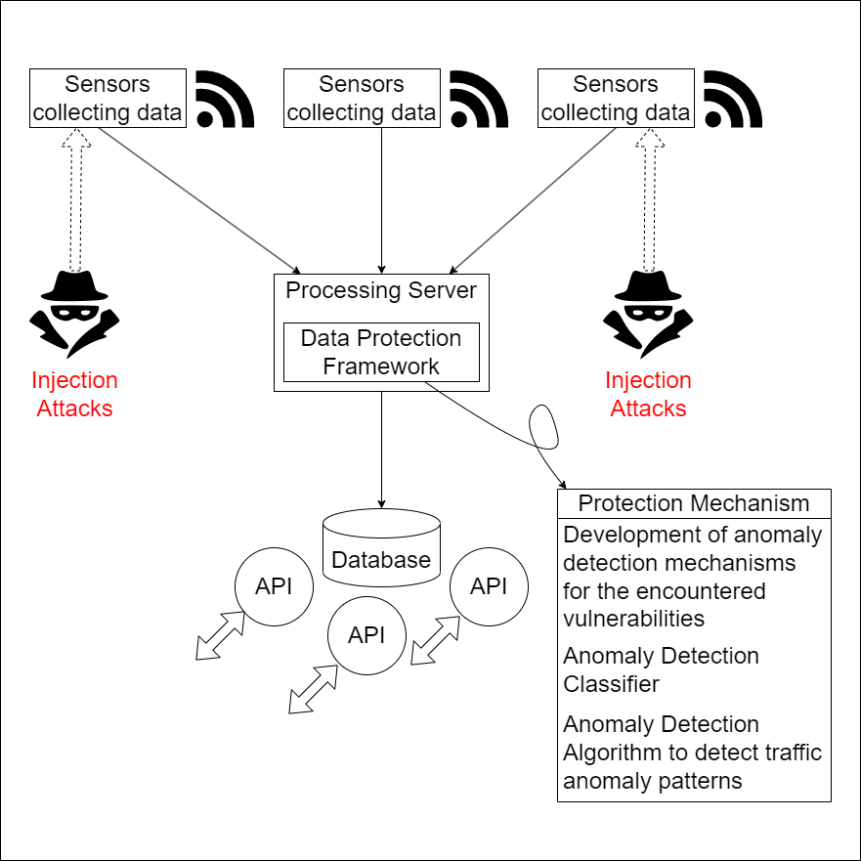
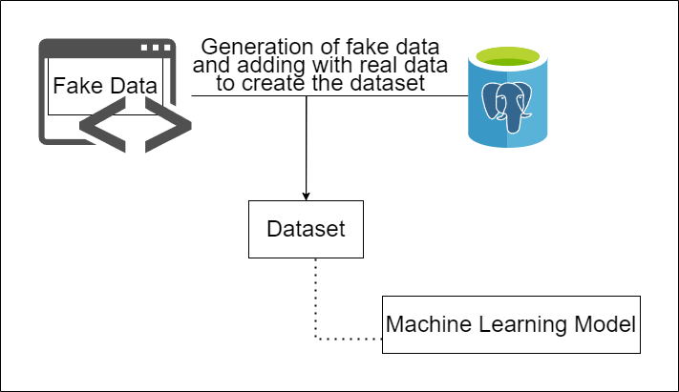
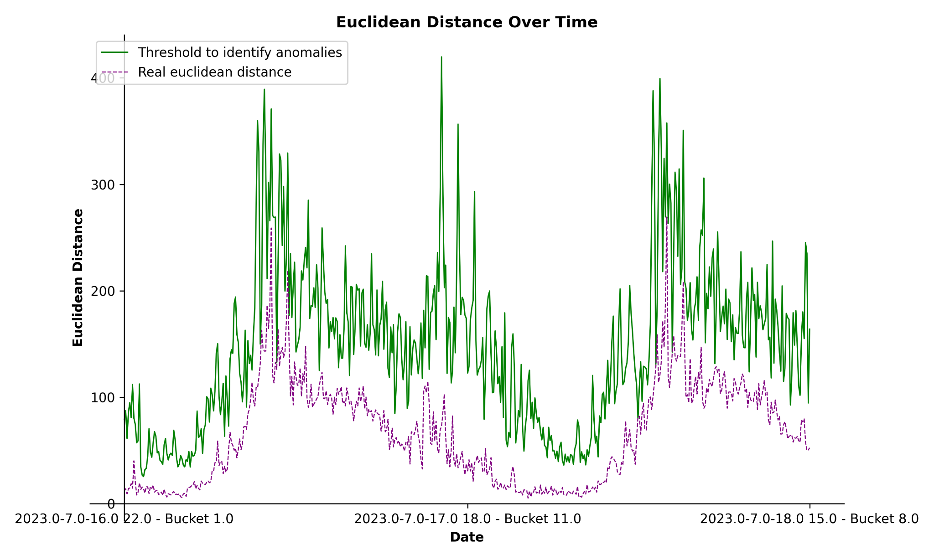

"Evaluating Data Manipulation Threats in WiFi-based People Counting: Risks and Defenses"
Sarah Asad, Anthony J. Bustamante, Ishraq Haider Chowdhury, Syed Ibrahim Khalil
Goals
Motivation
Identifying vulnerabilities in current Smart City architecture
Testing out the security of the sensors
Development of data protection framework
Project Architecture
-
Image Credits: Simon Weckert
Data Generation
Experiments and Results
We simulated the topology on VM and injected data and random noise to the normal traffic to further analyze anomaly patterns
The anomaly detection classifier is able to detect any type of data injection attack with 100% precision
The anomaly traffic detection mechanism can detect flooding attacks with great precision
Future Work
Incorporating the implemented algorithms into the existing backend technology
Implementing safeguards for MAC Spoofing
Implementing safeguards to protect privacy
Continuing Security Enhancement
unterstützt durch die TechnologieAllianzOberfranken

